Slide 1



KONGU ENGINEERING COLLEGE
PERUNDURAI ERODE-638060
DEPARTMENT OF
ARTIFICIAL INTELLIGENCE
Big Data Analysis Project
WEB SERVER LOG ANALYSIS
USING PYSPARK
Team Mentor : Mr. K LOGESWARAN
Team Members : VASUGI M - 21ADR057
SUJIT B - 21ADL053
AKILESH T - 21ADR002

Slide 2
INTRODUCTION
Web server log analysis using PySpark is a powerful way to gain insights from the vast amount of data generated by web servers.
PySpark is a Python library that allows you to work with big data and perform distributed data processing using the Apache Spark framework.
This combination makes it an excellent choice for processing and analyzing web server logs, which can be quite large and contain valuable information about user behavior, website performance, security threats, and more.

Slide 3
Why to perform web server log analysis?
Web servers generate logs that record every request made to the server, including information like IP addresses, timestamps, HTTP methods, requested urls, status codes, user agents, and more. These logs can provide insights into
Website traffic
Errors
User behavior.

Slide 4
Objective
Understanding User Behavior: To gain insights into how visitors interact with your website, what content they are interested in, and the paths they follow during their visit. This understanding helps in tailoring the user experience to meet their needs.
Website Performance Optimization: To identify and address performance issues, such as slow-loading pages, server errors, or other bottlenecks, with the goal of improving website speed and responsiveness.
Content Strategy Improvement: To refine your content strategy based on which pages are the most popular, which content is engaging, and what content needs improvement. This can lead to more effective content creation and marketing strategies.

Slide 5
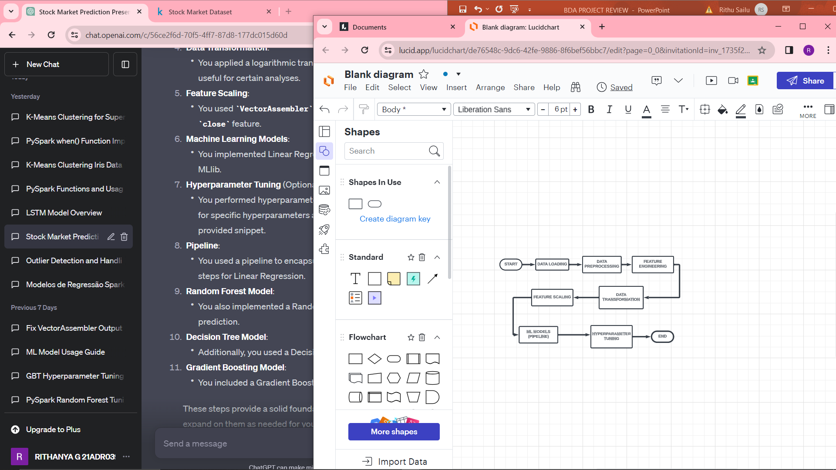
WORKFLOW

Slide 6
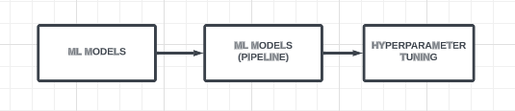
MODEL TO BE USED
Linear regression
Random forest
Decision tree
Naïve bayes

Slide 7
100 Continue
101 Switching Protocols
200 OK
201 Created
202 Accepted
203 Non-Authoritative Information
204 No Content
205 Reset Content
206 Partial Content
300 Multiple Choices
301 Moved Permanently
302 Found
303 See Other
304 Not Modified
305 Use Proxy
307 Temporary Redirect
400 Bad Request404 Not Found
405 Method Not Allowed
406 Not Acceptable
407 Proxy Authentication Required
VARIOUS RESPONSE CODES

Slide 8
404 Not Found
405 Method Not Allowed
406 Not Acceptable
407 Proxy Authentication Required
408 Request Timeout
409 Conflict
410 Gone
411 Length Required
412 Precondition Failed
413 Request Entity Too Large
414 Request-URI Too Long
415 Unsupported Media Type
416 Requested Range Not Satisfiable
417 Expectation Failed
500 Internal Server Error
501 Not Implemented
502 Bad Gateway
503 Service Unavailable
504 Gateway Timeout
505 HTTP Version Not Supported
VARIOUS
RESPONSE
CODES

Slide 9
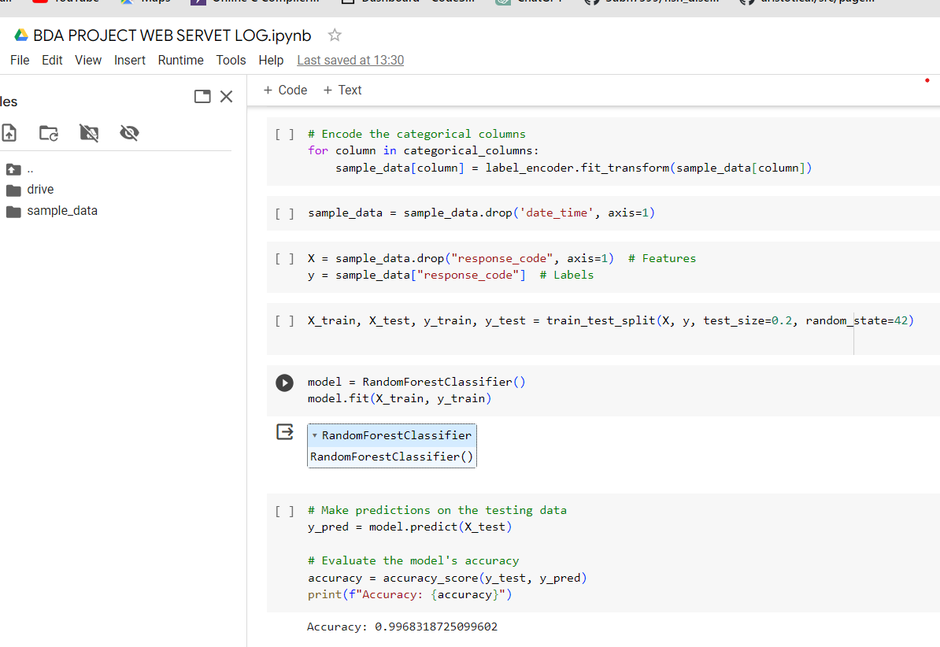
CODE:-
RANDOM FOREST

Slide 10
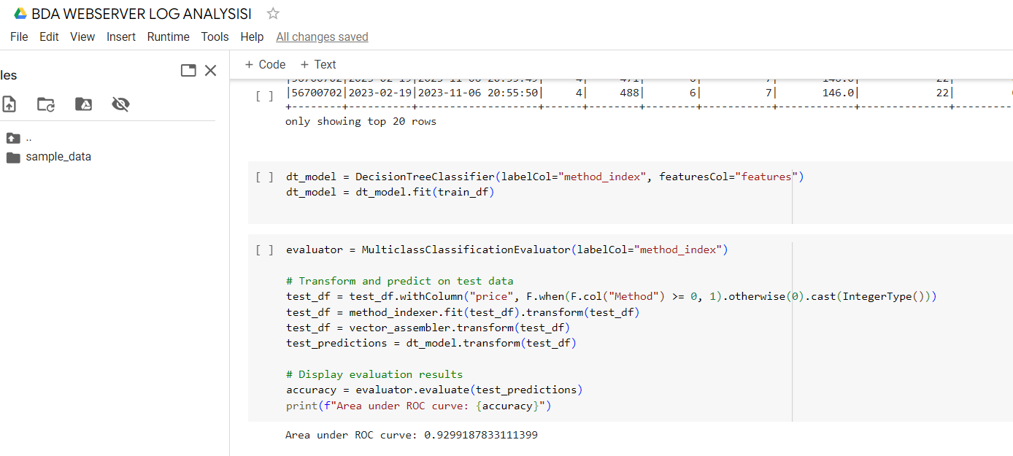
DECISION TREE CLASSIFIER

Slide 11
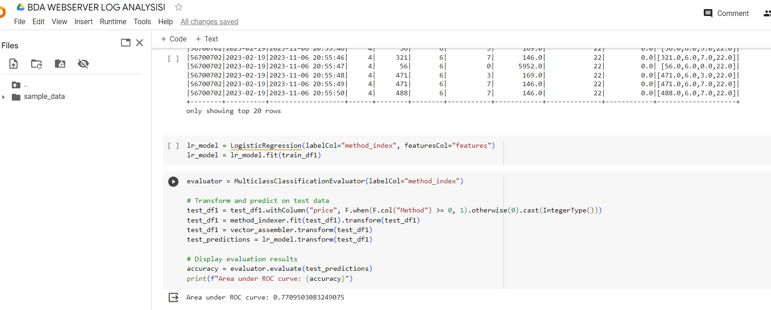
LOGISTIC REGRESSION

Slide 12
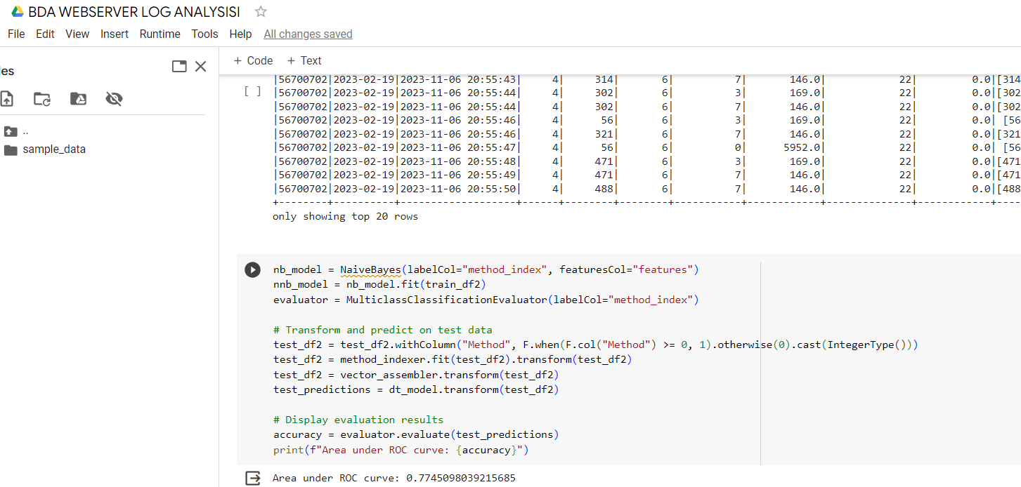
NAÏVE BAYES

Slide 13
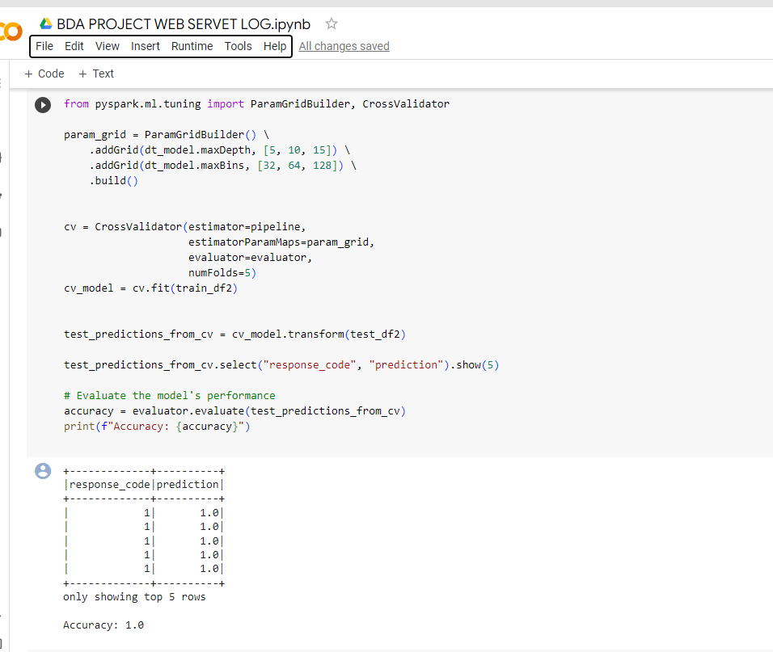
HYPERPARAMETER TUNING FOR RANDOM FOREST

Slide 14
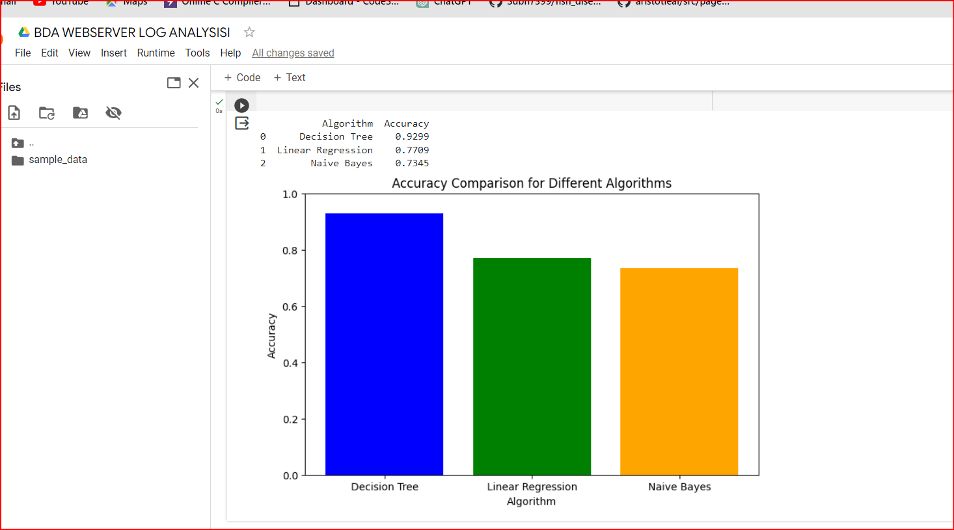
COMPARISON OF ALOGORITHMS

Slide 15
CONCLUSION
web server log analysis using PySpark and the Random Forest algorithm is a valuable approach for organizations looking to gain insights, improve security, and optimize their online presence. With its ability to provide high accuracy and handle large datasets, this combination of tools is well-suited for a wide range of web server log analysis tasks.

